Slide 1
Git: A Brief Practical
16/06/2020

Slide 2
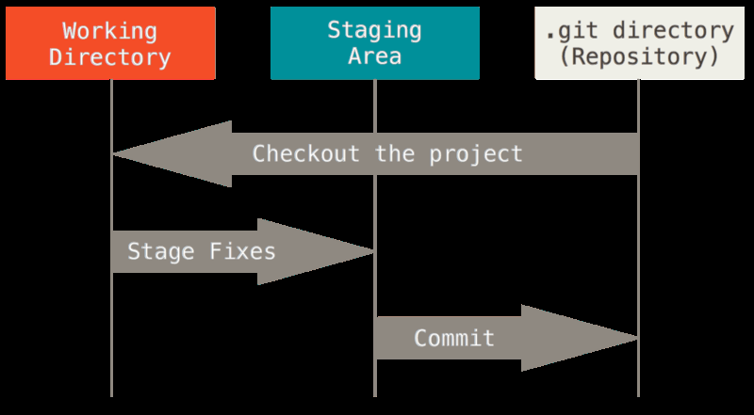
Jargon-Busting
Repository or “Repo”
Commit (Checkin)
Staging
Checkout
Pro Git, Chacon and Straub

Slide 3


My First Repo
Two ways to create a Repo:
Initialise it locally git init
Clone from a remote server git clone [URL]
Try it now
URL: https://github.com/jonvw28/forestecol_gitclass
github.com

Slide 4
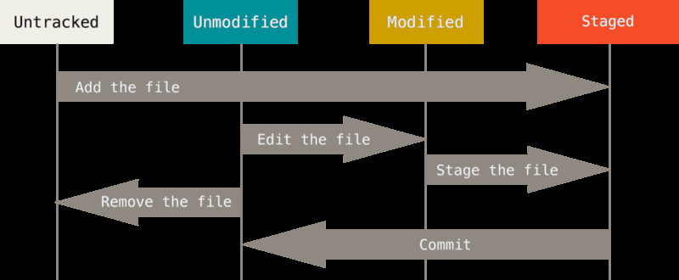
Status of a file
Files can be:
Unmodified
Modified
Untracked
Staged
Pro Git, Chacon and Straub
Commands for the above:
git add [file]
git commit

Slide 5
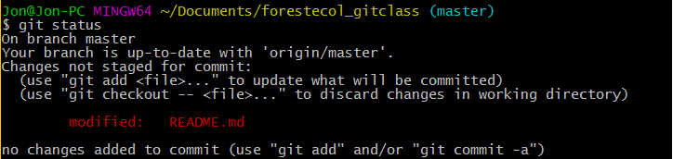
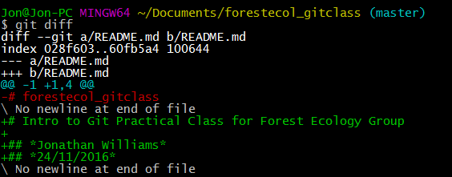
How do I know what’s changed?
Check files
git status
Check Changes within files
git diff

Slide 6

How do I create a snapshot?
Make sure all relevant files are staged
git add
git add -A
Now commit
git commit
Make sure you include a useful message

Slide 7
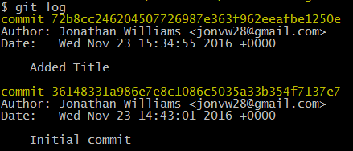
Looking at the History
git log

Slide 8
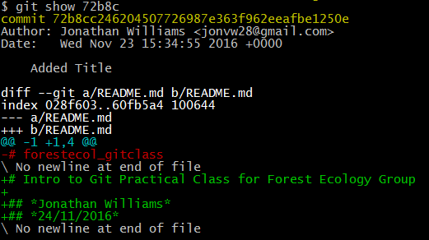

Looking Back
git show [SHA-1]
git show [SHA-1]:[path to file]

Slide 9

Your turn
Create a new file in the repo from before
Eg jon_w.txt
Check the status of this
Stage it
Now add some text to the file
Check the status again
Commit your changes (hint: are they staged?)
Can you see what README.md looked like before this commit?

Slide 10
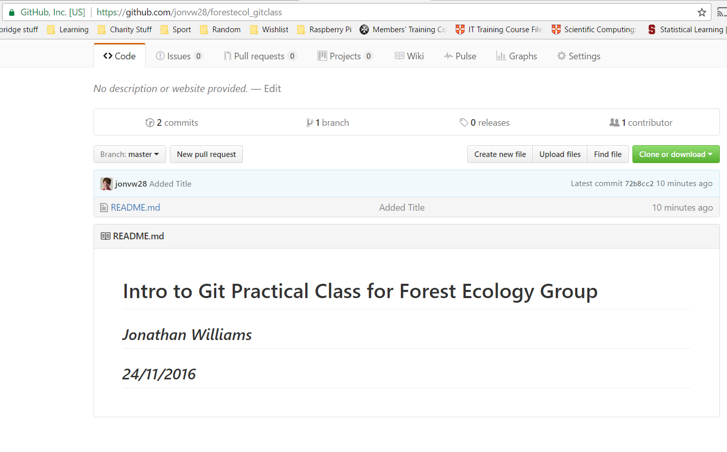
Backing up to Github Server
Central Copy
‘Push’ updates from your local copy
Open-source Sharing

Slide 11
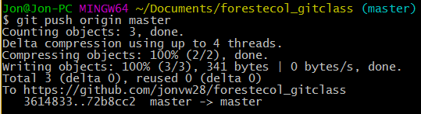
Pushing
git push [external server] [branch]
For now
Remote Server = origin
Branch = master *
Branching is very powerful
See Handout Slides for more
* NB: this is about to change for github from a default of master to something else for the main branch

Slide 12
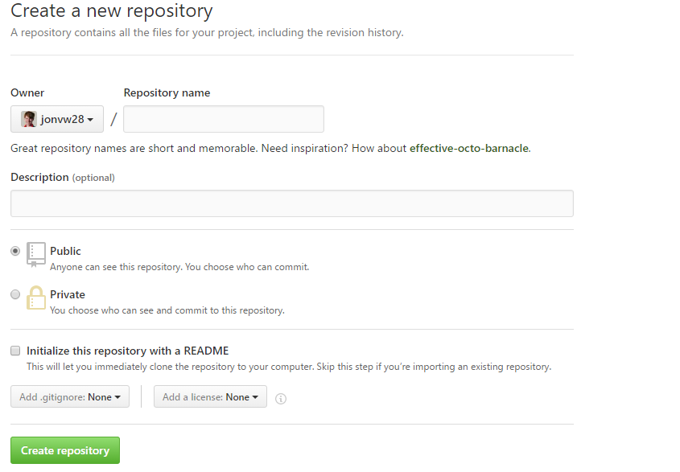
Final Practice
Create a Repo on Github
Check the box that says initialise with README
Clone it to your PC
Open README.md and add your name
Create a Commit for this change
Push this commit to the GitHub Repo
Check Github to see if your name is there!

Slide 13
Any Questions?
Access all of the slides from the repo
https://github.com/jonvw28/forestecol_gitclass

